Slide 1
Python for Data Science
Data Science and Innovation for Human Capital
November 14, 2019
Welcome!
Here are the materials
http://github.com/worldbank/Python-for-Data-Science/

Slide 2
Participant outcomes
With no prior coding skills assumed, participants should be able to:
understand basic programing concepts;
know the structure of Python and its core libraries;
write basic programs;
self-teach next steps.

Slide 3
Participant outcomes
With no prior coding skills assumed, participants should be able to:
understand basic programing concepts;
know the structure of Python and its core libraries;
write basic programs;
self-teach next steps.

Slide 4
Programming shares many concepts from everyday life.

Slide 5
Guess the output (1)
Ingredients
Half cup butter
Half cup cream
2.5 cups flour
1 t. salt
1 T. sugar
4 cups riced potatoes (cold)
Method
1. Mix all ingredients
2. Knead thoroughly
3. Form into 20 balls.
4. For each ball:
Spread flour on cloth
Roll ball in circle with rolling pin
Fry on griddle
Flip and fry other side

Slide 6
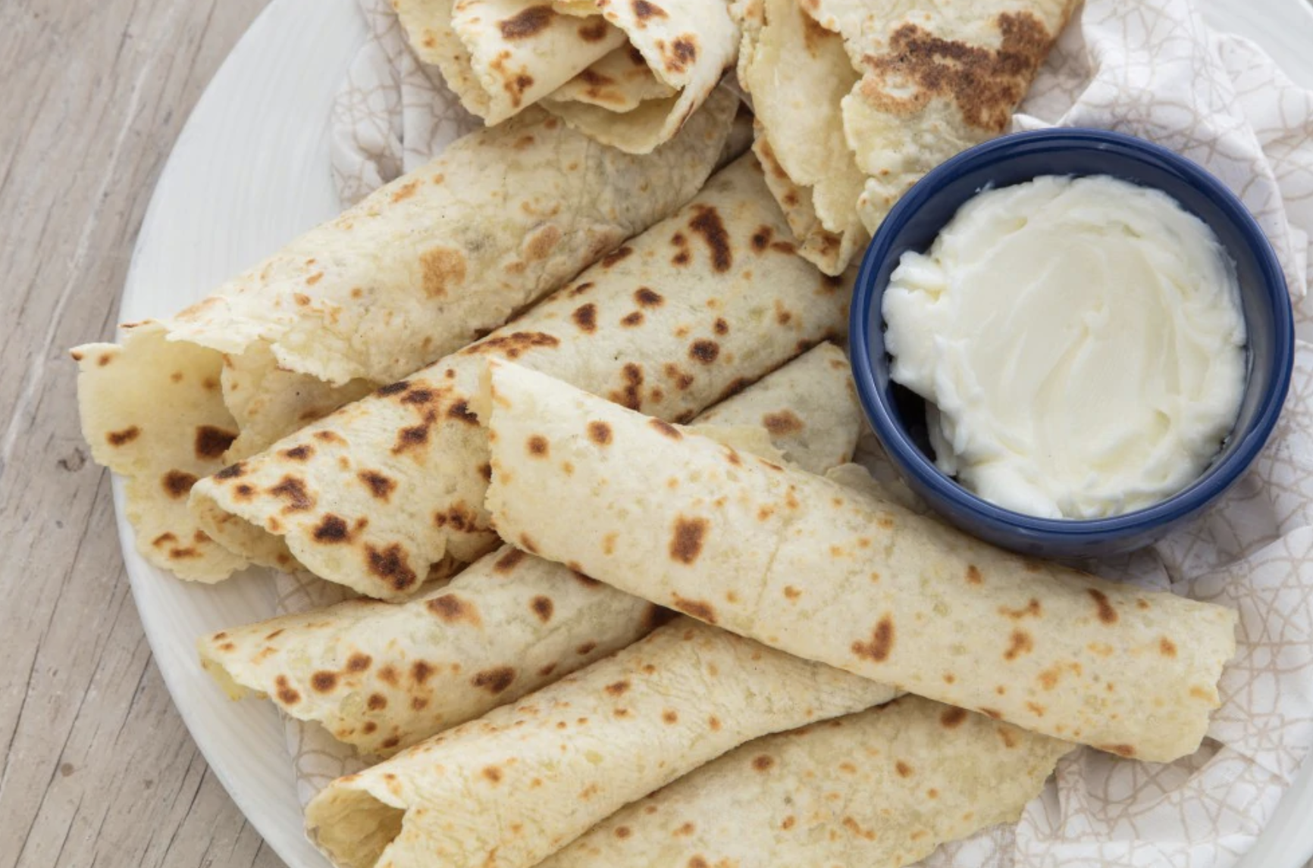
Credit: Think Python! Allen Downey
Lefse, Norwegian pancakes (makes 20)

Slide 7
Coding shares many elements with cooking
A vocabulary of words, abbreviations and symbols.
Rules about what can be said and where – their syntax.
A sequence of operations to be performed in order.
Repetition of some operations (loops) or logical tests (conditions)
Sometimes, a reference to procedures defined elsewhere (functions)
Credit: Think Python! Allen Downey

Slide 8
Specialized syntax, loops, functions and logic are all common ways of thinking in other domains (like cooking).
Ingredients
Half cup butter
Half cup cream
2.5 cups flour
1 t. salt
1 T. sugar
4 cups riced potatoes (cold)
Method
1. Mix all ingredients
2. Knead thoroughly
3. Form into 20 balls.
4. For each ball:
Spread flour on cloth
Roll ball in circle with rolling pin
Fry on griddle
Flip and fry other side

Slide 9
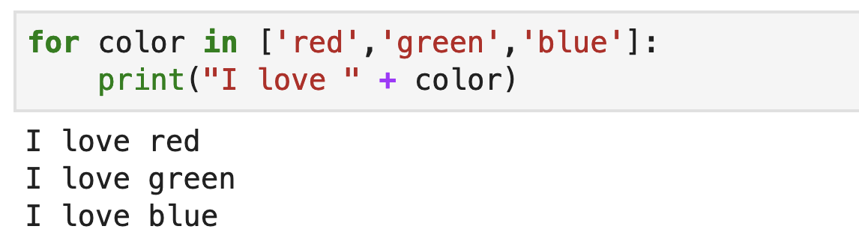
Guess the output (2)
loop
list
elements of syntax
text
syntax (indentation)

Slide 10
Data science - a popular representation:

Slide 11
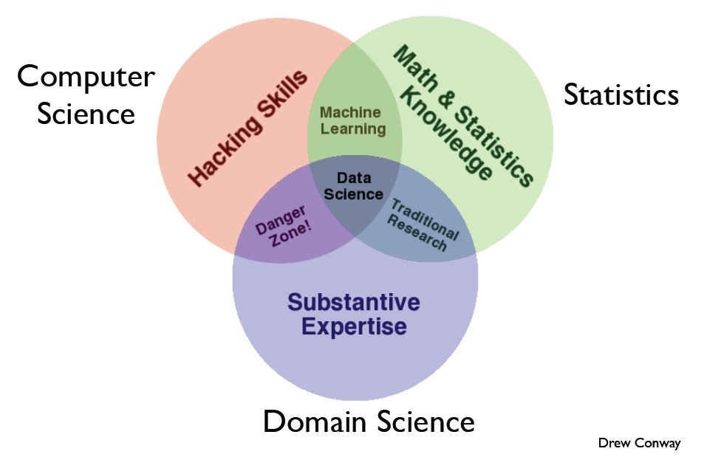
Computer
science
Math & stats
Domain expertise

Slide 12
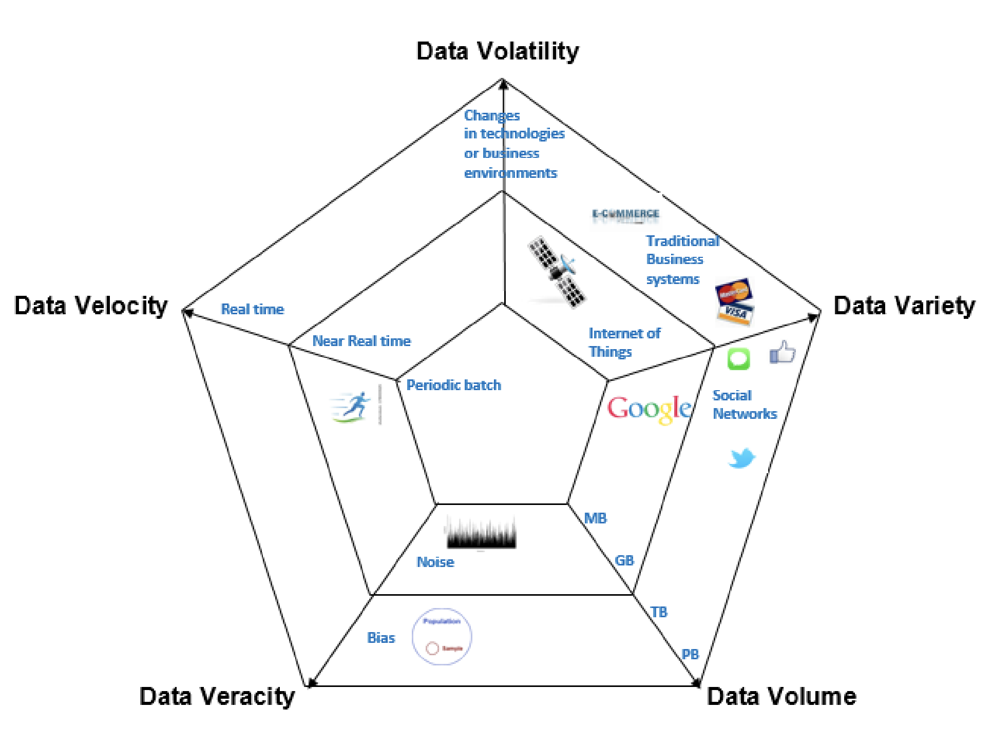
Source: IMF /
Doug Laney

Slide 13
Why Python for Data Science?

Slide 14
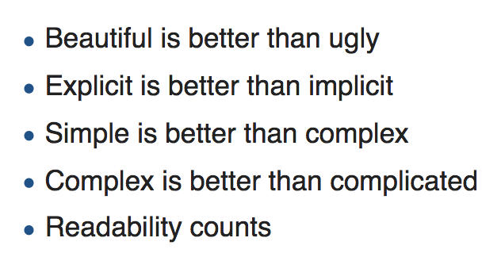
Why Python for data science?
Guido Van Rossum – the Zen of Python:
Python’s Benevolent Dictator for Life

Slide 15
Why Python for data science?
Guido Van Rossum – the Zen of Python:
Whitespace instead of symbols
tabs, indentation and line-breaks matter
code remains uncluttered
Variable types determined automatically
no need to declare the type of your variables before assigning values
Intuitive grammar
PEP8: style guide
Python’s Benevolent Dictator for Life

Slide 16
Three advantages:

Slide 17
1. Python is popular
Large user community
Well-maintained libraries
Online guidance

Slide 18
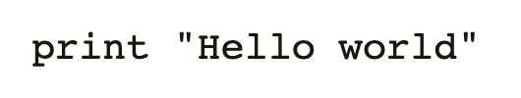
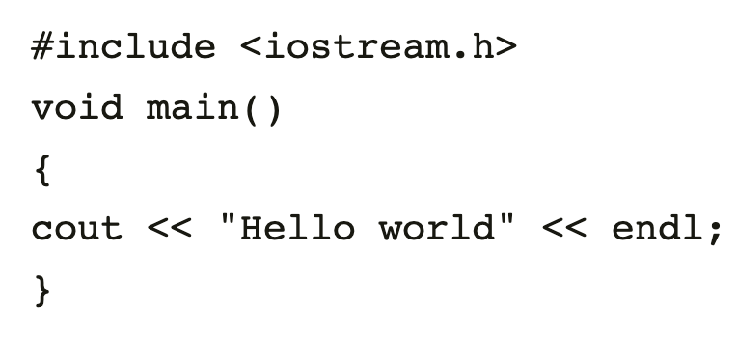
2. Easy to learn and share
WHY PEOPLE LIKE IT:
Code is intuitive and expressive (compare C++)
Suited to large quantities of data
Transparent, reproducible research through Jupyter Notebooks

Slide 19
3. Thriving ecosystem of tools
Get data
Clean data
Modeling and analysis
Evaluate and present
Data science work-flow
BeautifulSoup
mySQL client
API clients (Twitter, ESRI, OSMNx…)
Pandas
Geopandas
Rasterio
Numpy
scipy
statsmodel
SciKitLearn
Jupyter Notebook
Matplotlib
Flask
Examplelibraries

Slide 20
Getting started
GitHub repository: github.com/worldbank/Python-for-Data-Science/Nov_2019_HD_workshop
First exercise
Find the ‘part 1’ folder; scroll all the way down;
click link for ‘0_notebooks_intro’
Starting with Colab
Ensure you’re logged on to your Google account
Click ‘connect’
De-select ‘reset all runtimes’ and click ‘run anyway’

